Slide 1
ZOOM Self-Recording Manual

Slide 2
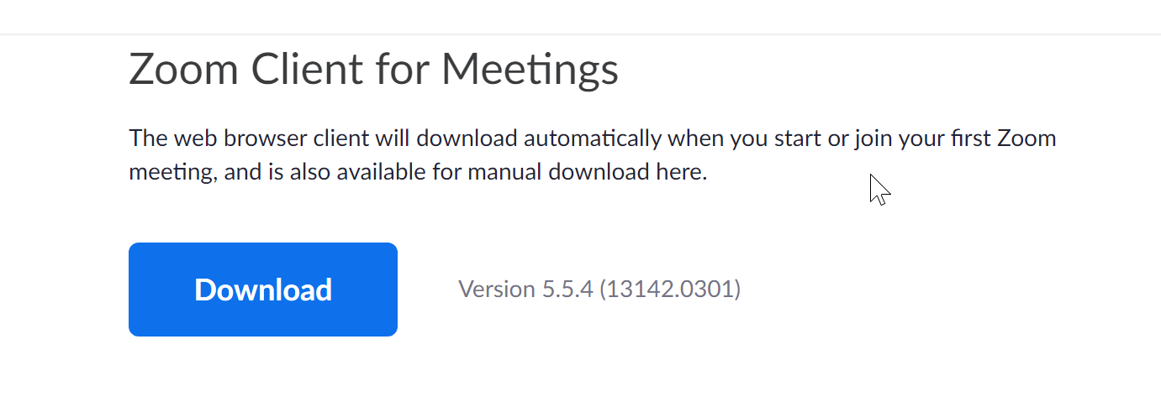
Download and Install Zoom
Please download the Zoom Client for Meetings and install first.
Download Link: https://zoom.us/download#client_4meeting
ZOOM

Slide 3
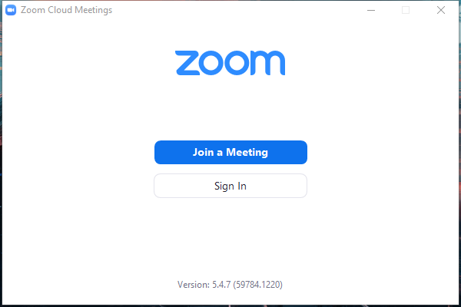
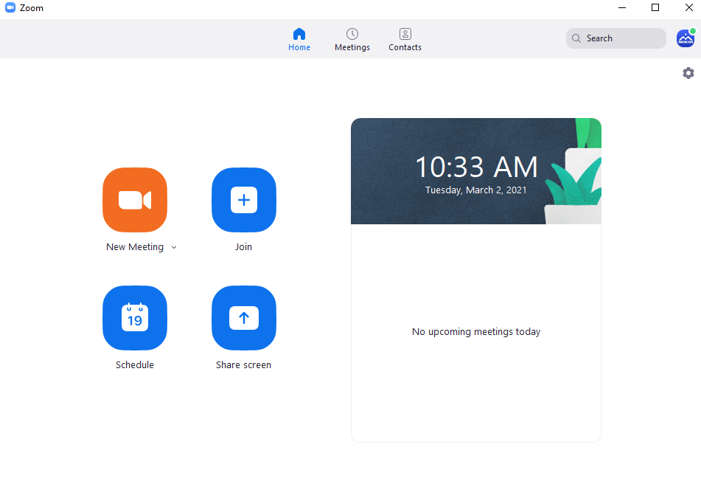
Step 1: Sign in Zoom
Step 2: Click on New Meeting
Sign in and Start a Meeting

Slide 4
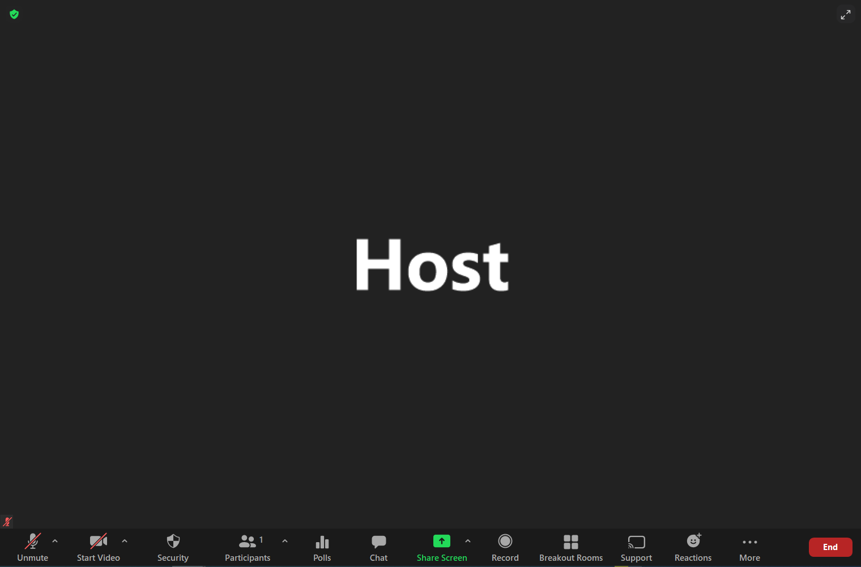
Control Panel: Basic Operation
Start and Stop Video
Mute and Unmute sound

Slide 5
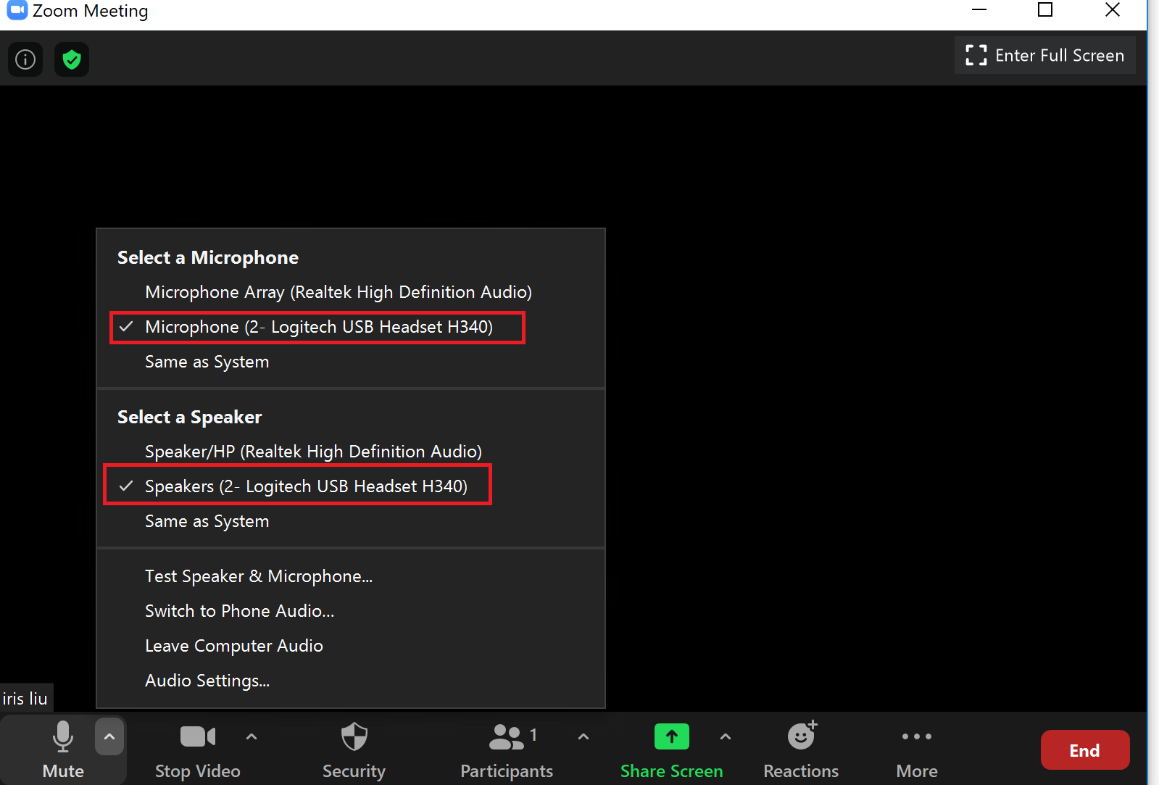
Control Panel: Basic Operation
Click on the small arrow at the “Mute” button to select Microphone and Speaker that you’d like to use to record your talk.
Go to the “Audio Settings” to do settings of video, audio and recording.

Slide 6
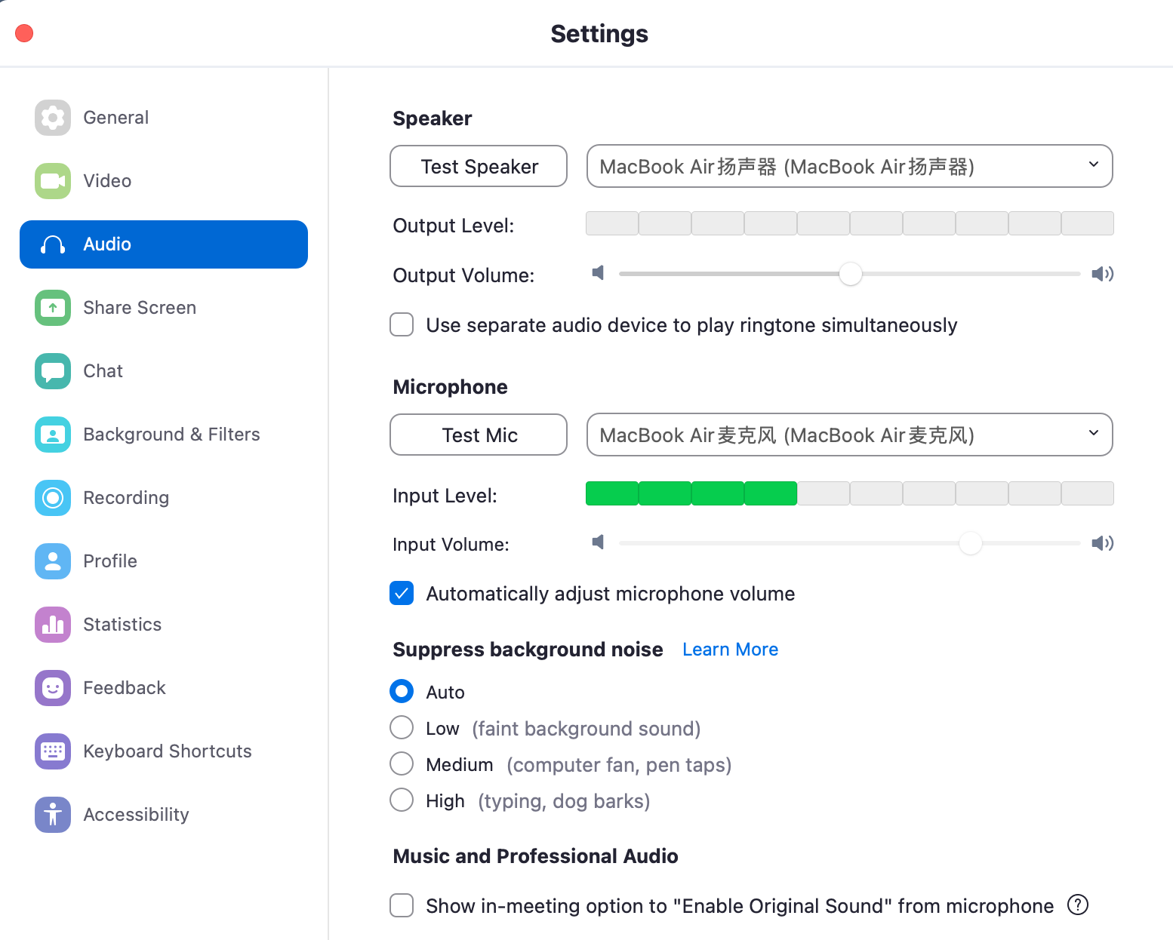
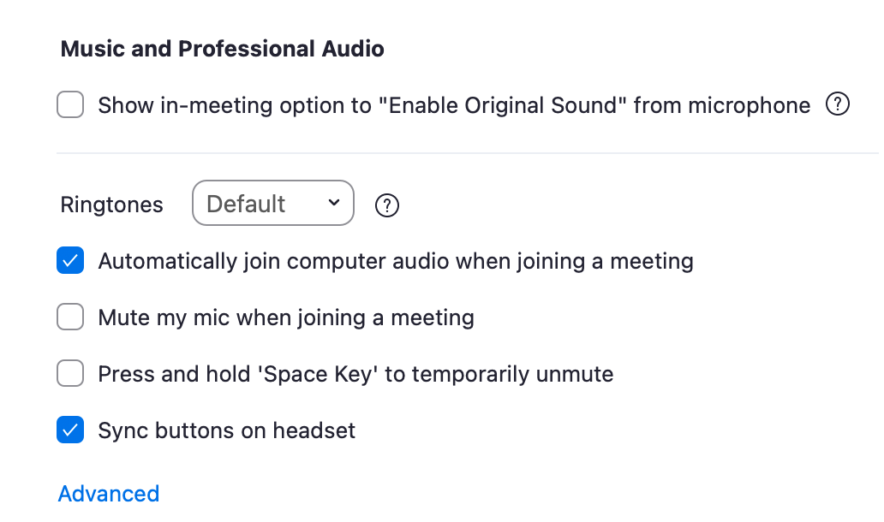
Audio Setting
1. Test your Speaker
2. Test your Mic
3. UN-SELECT “Press and hold space key to temporarily unmute yourself”

Slide 7
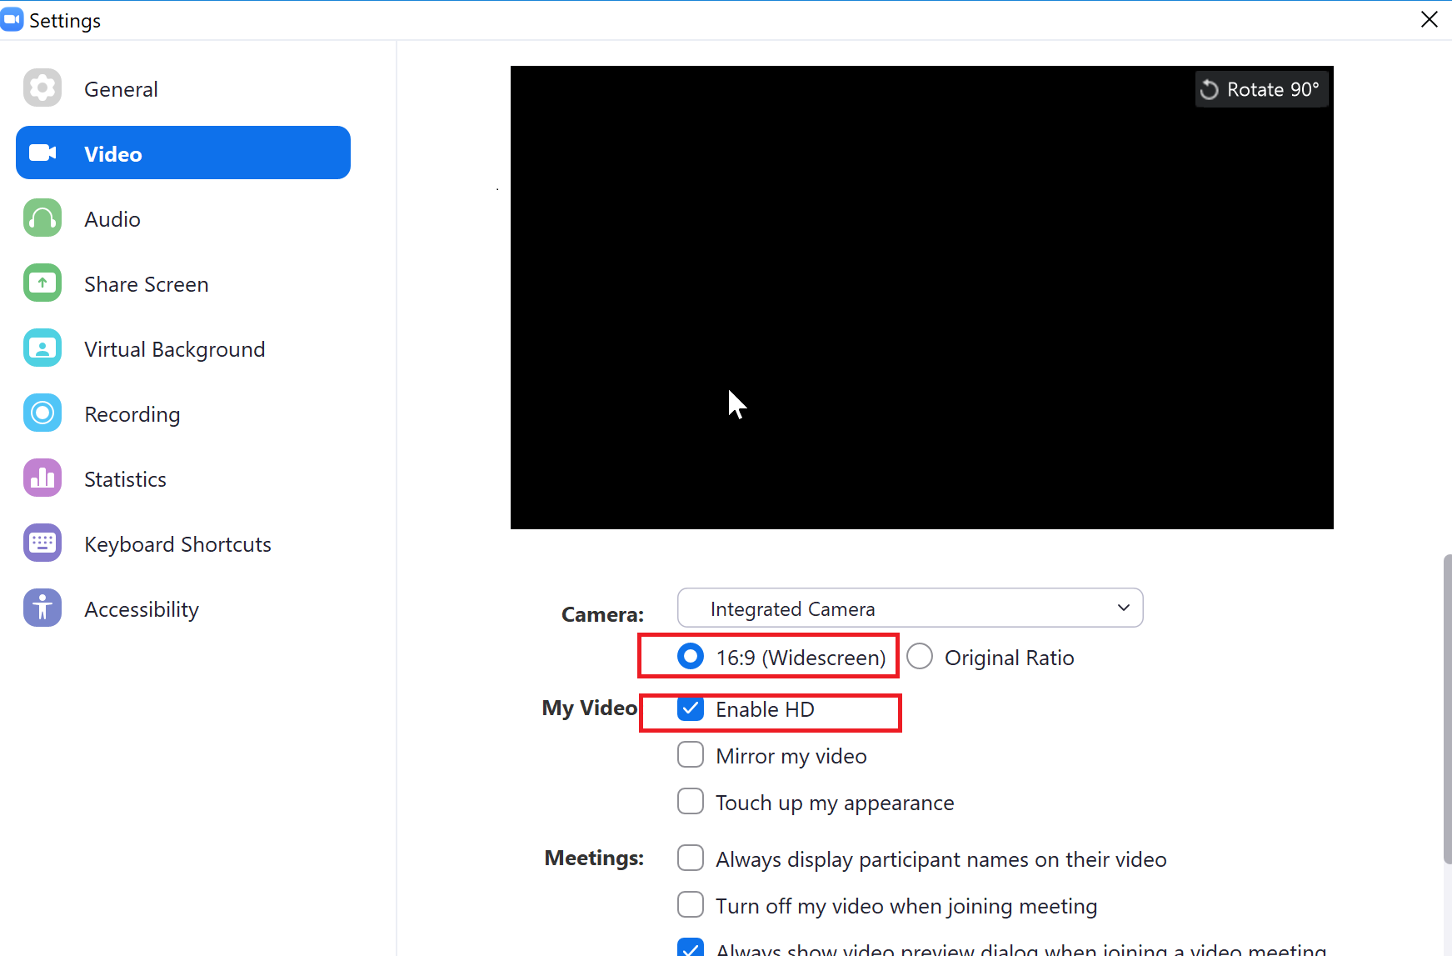
Video Setting
Select 16:9 (Widescreen) and Enable HD
UN-SELECT “Always display participant names on their video”

Slide 8
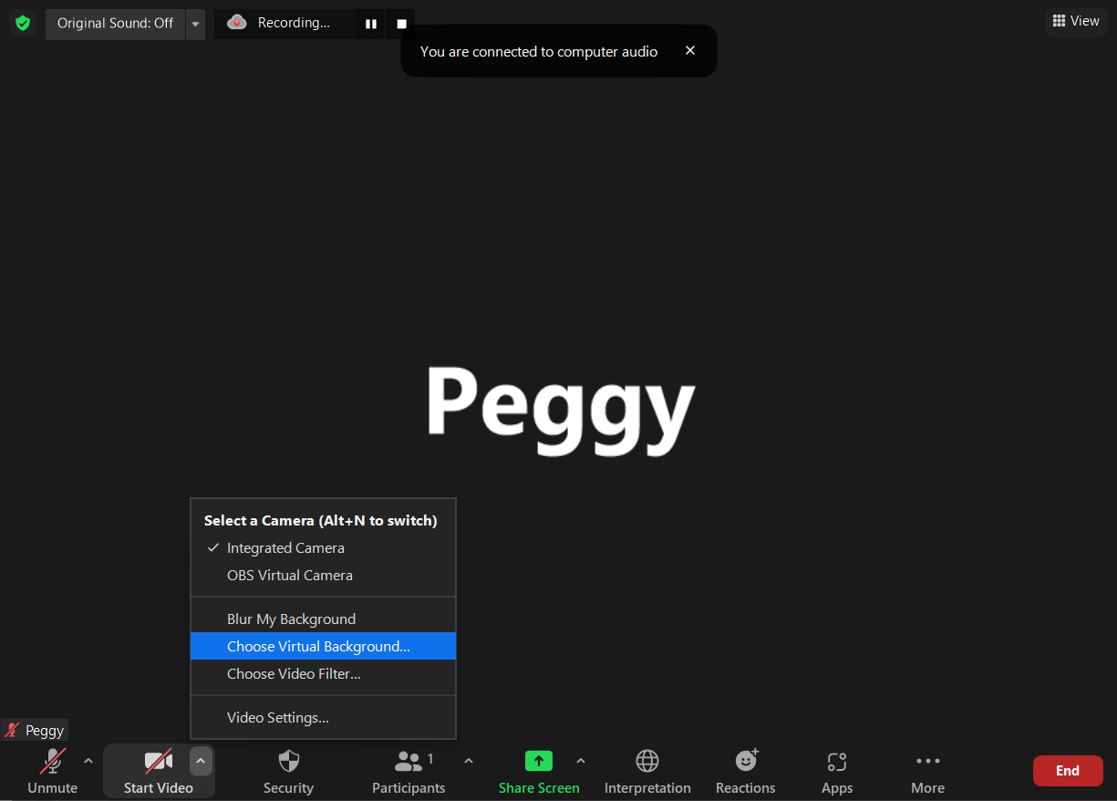
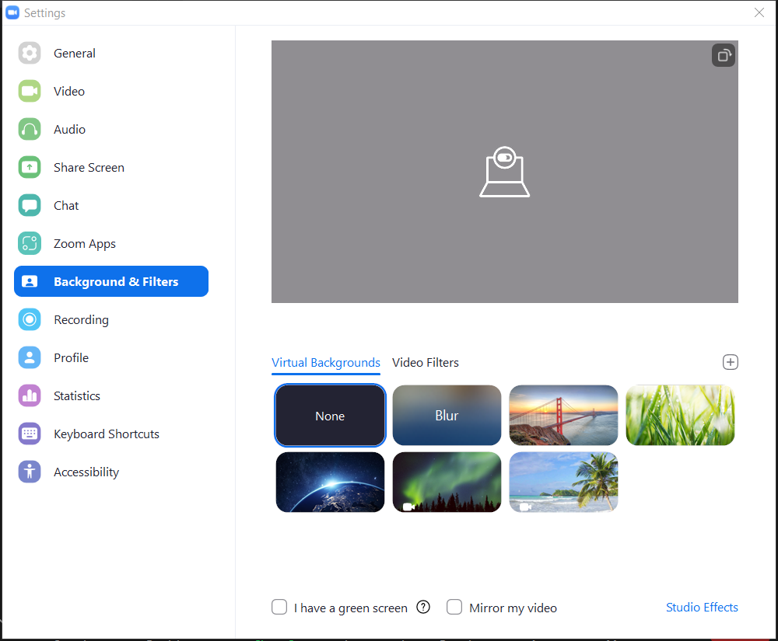
Virtual Background Setting
Click Choose Virtual Background
and open Background & Filters setting
Click the “+“ button to add the background picture

Slide 9
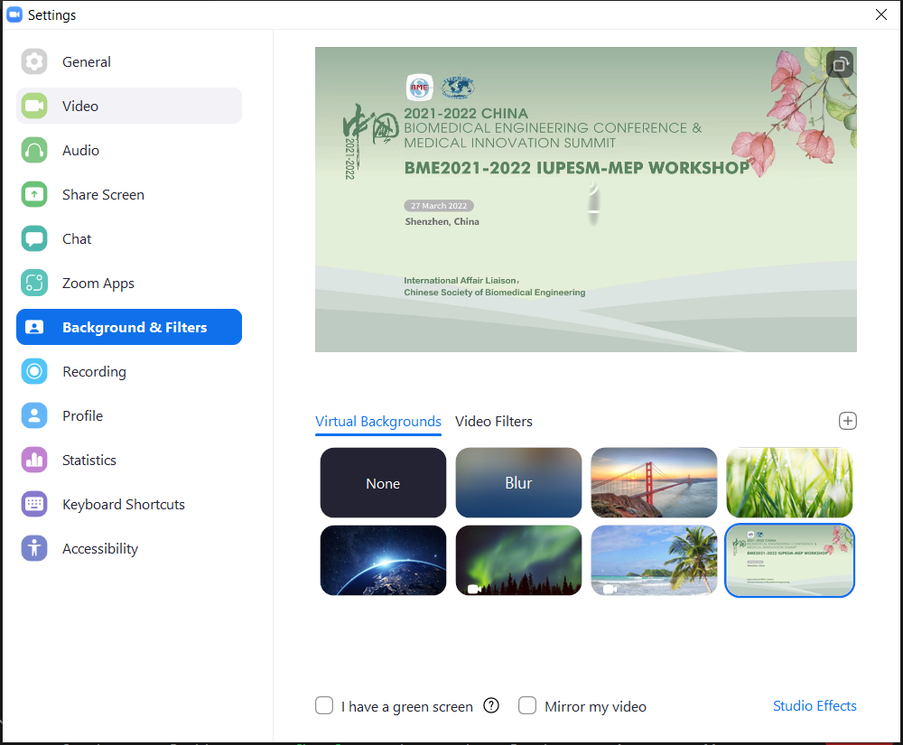
Virtual Background Setting
Virtual Background is required for this meeting. The background picture will be sent to you through email with the recording guideline.
Please refer to the instructions above when using this image.

Slide 10
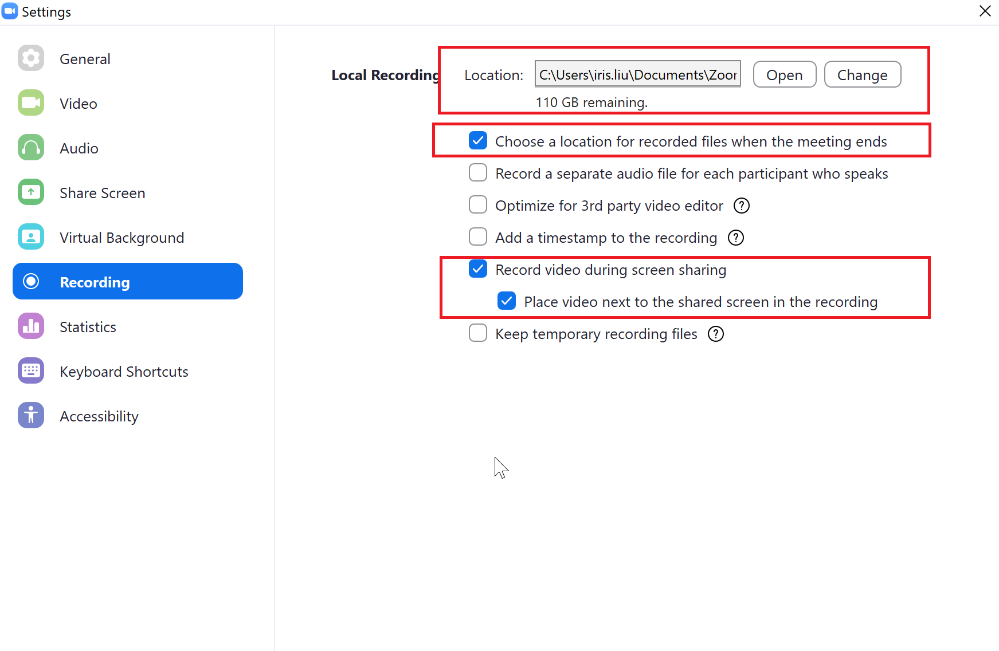
Recording Setting
You can choose where you would like to store your recording.
Please select “Choose a location for recorded files when the meeting ends” and it will give you an option to save the recording to the folder that you wish to.
You will be able to see the video after you end the current meeting.
Important
Please select “Record video during screen sharing” and “Place video next to the shared screen in the recording”.
These two options can ensure that your PowerPoint is not blocked by the camera.

Slide 11
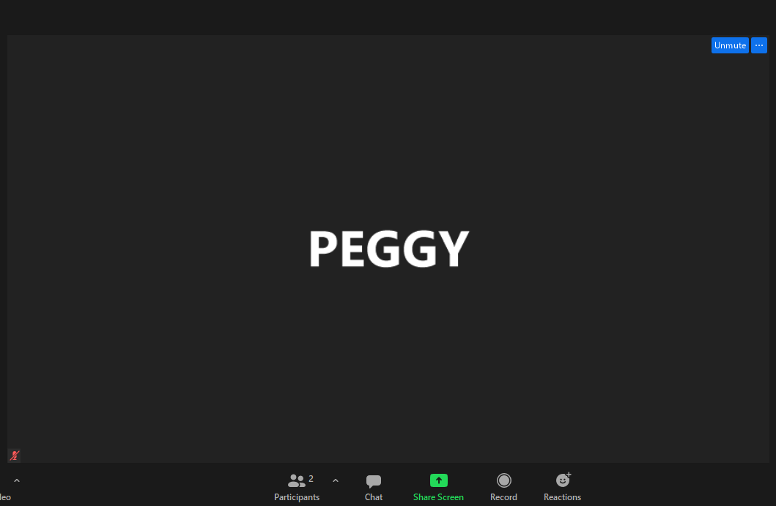
Start Recording
Click “Record” button to start recording

Slide 12
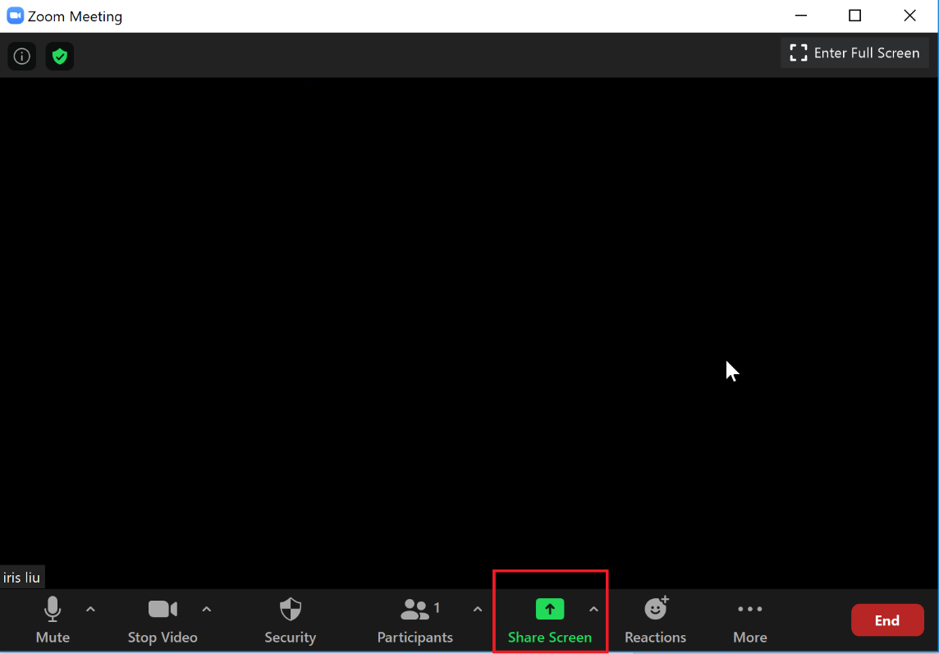
Share Screen: How to share your slides?
Step 1:
Open you slides from PowerPoint
Step 2:
Return to Zoom,
Click Share Screen
Share Screen

Slide 13
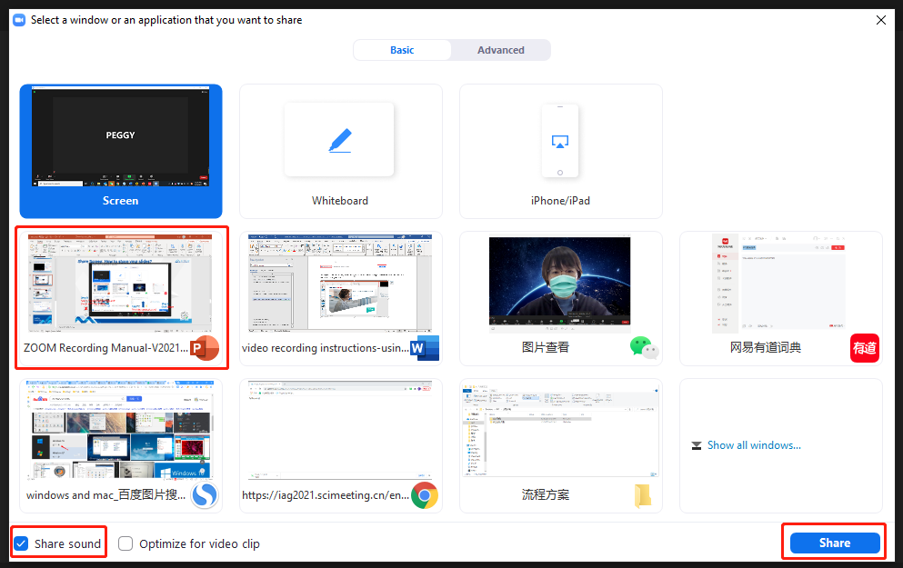
Share Screen: How to share your slides?
Step 1:
Find the application of your slides
Step 2:
Select “Share Sound”
if your PPT has a video
Step 3: Click Share

Slide 14
Screen Share and Recording
When your slides are shared, please move the video window to the right top corner.
Click here to play your PPT in full screen

Slide 15
Stop Recording
When your talk finishes, move your mouse to the top and a bar will be shown.
Click on the “More” button, click “Stop Recording”.
Click “Stop Share” to quit screen sharing.
Click “End Meeting” to end the current meeting.

Slide 16
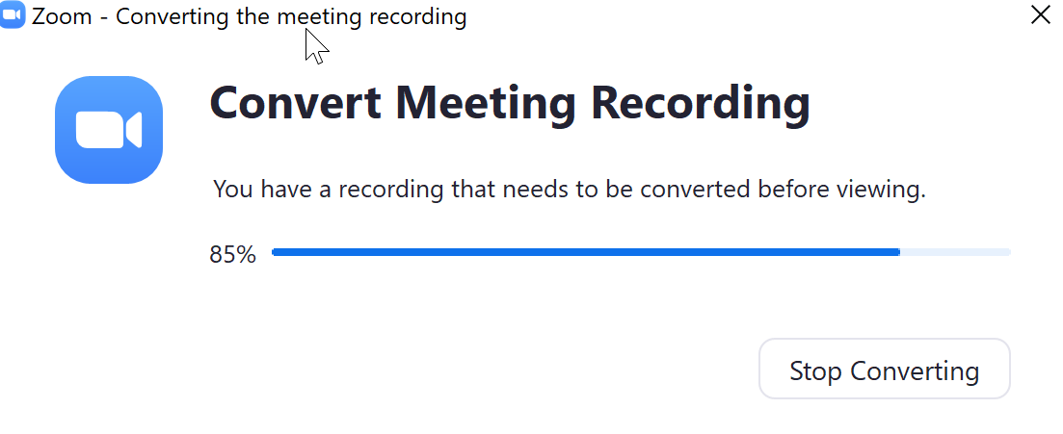
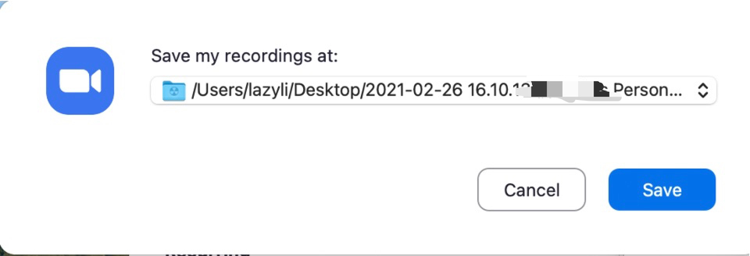
Find Meeting Recording
Step 1:
After the meeting is ended, Zoom will start converting the meeting recording.
Step 2:
When the converting finishes, you will be asked to select a folder where you would like the recorded files to be saved.
Open the folder where you save the file, open the file and check if it’s satisfying.

Slide 17
Check your Meeting Recording
Please open your video file and check if:
Sound is clear
Layout is correct: video is next to the shared slide screen.
This is a sample of correct meeting recording.

Slide 18
Thank You!
Please contact us for Technical Assistance.
Name：CJK 2022
E-mail：cjk_2022@163.com

